Slide 1

Social Conflicts Studied by Statistical Physics Approach and Monte Carlo Simulations
Hung T. Diep (1), Miron Kaufman (2) and Sanda Kaufman (3)
(1) Univ. Cergy-Pontoise, France, (2) Department of Physics, Cleveland State University, USA (3) Levin College of Urban Affairs, Cleveland State University, USA.
Outline
Statistical physics & sociophysics
Time-dependent Mean-Field Theory
Monte Carlo Simulation
Results: 2-group conflicts, 3-group conflicts
Conclusion

Slide 2
I. Statistical Physics and Sociophysics
Spin language borrowed from statistical physics for sociophysics
Spin => a variable S which represents an individual. It has a number of values which indicate the « state » of the individual.
Example 1: In a problem where Yes or No are requested as opinion => S=1 (Yes) and S=-1 (No). If we need Yes, No and Without Opinion, then S=1, -1 and 0
Example 2: In a problem where an individual can have 5 degrees of opinion, from very negative attitude to very positive, we can define S=-2, -1, 0, 1, 2 => Discrete spin models
Example 3: Continuous variation of the individual state! => Continuous spin models

Slide 3
Spin models
According to the problem treated, one can choose an appropriate model
Ising model: +/- 1
Potts models: q-state model, clock-model
Continuous spin models: XY, Heisenberg
Quantum spin models
….

Slide 4
Why can spins represent individuals in a society?
Preference of an individual can be quantized on a scale
Incertainty on his/her preference can be modelled by fluctuations due to outside factors such as social unrest, « social temperature », interaction with others, ….
Humans vs spins: in stat physics, particularities of individuals are washed out in the averaging. Only common, dominant characteristics remain at the end.
Background on education, psychology, philosophy, politics, … determines actions of individuals , not their human uniqueness

Slide 5
INTERACTION:
Interaction between two individuals is given by
              E=-J (i j ) Si . Sj
where E is the energy, J the interaction strength.
If J (i j) >0, then the stable state of the two individuals is when they have the same opinion, namely E<0. When the individuals do not have the same « sign », then E>0, the situation between two individuals is a conflict. The value of E expresses the degree of conflict.
Interaction between individuals in a society: generalization of the above interaction. It can be short-range or long-range, geometry-dependent, …
BUT J(i j) can be different from J(j i)

Slide 6
Social temperature T
Social temperature T is a parameter which expresses the degree of social perturbation or social ambiance, social pressure (political, economic, security, …). T acts on each individual as follows: if T=0 (no perturbation), each individual is at his or her highest spirit (maximum value of S). At a finite T, the individual feels some unease. T thus acts as a disordering factor.
Individual state depends therefore on the ratio J/T
( J favors collective ordering while T represents social perturbation ).
Time-average, space-average over individual states: most common characteristics remain in macro-properties

Slide 7
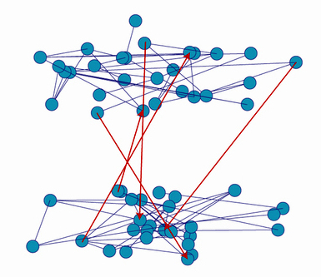
Intra-group & inter-group couplings
Intra-group
Inter-group
J1
J1
K12
K21
J2
J2
Notes:
Explain model perhaps without equation (say it is available); especially good for large numbers of people

Slide 8
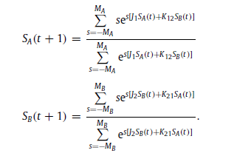
Mean-Field Equations:

Slide 9
Mean-Field results (2 groups)
Oscillations:

Slide 10
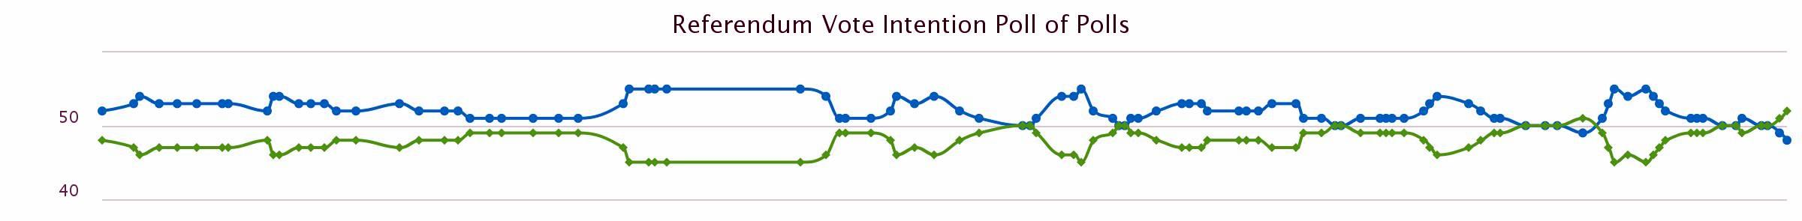
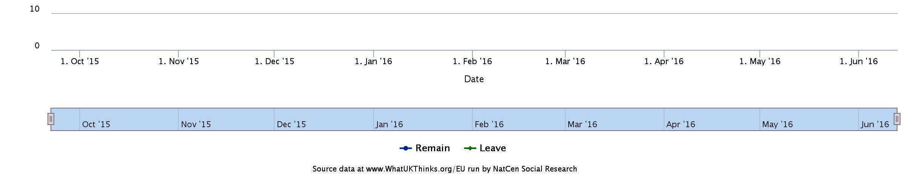
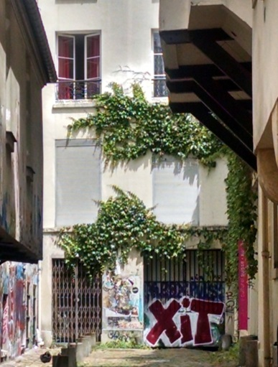
Example 1: “Brexit” referendum
Referendum Vote Intention Poll of Polls
50 %
%
date
Oct ‘15
Jun ‘16
remain leave
50 %
Model anticipation
time
BR
Notes:
Stronger interaction between groups than within groups
Remember it’s qualitative and non-predictive. However, it can be used to explore what might happen if some of the bonds change, for instance through stronger persuasion efforts by either side or both.

Slide 11
Example 2: US elections, 2016 in terms of attitudes
Republicans
s1, s2
Democrats
Time
Notes:
Stronger interaction within groups than between groups
red republicans; blue democrats; republicans have weaker intra-group strength than democrats; republicans are influenced by democrats more than democrats by republicans K12>K21

Slide 12
Monte Carlo Simulation : role of social perturbations

Slide 13
Three-Group Conflict: Serbia-Herzegovina-Croatia 2018:
High T=> all initial conditions lead to the same fixed point (attractor), see curve on the right
High T (=1.45) , damped oscillations and attractor

Slide 14
Three-Group Conflict: Serbia-Herzegovina-Croatia 2018
Intermediate T (=1) , oscillations and attractor line
Low T, fragmented attractor into discontinued lines

Slide 15
References
[1] Diep H. T., Kaufman M., and Kaufman S.,
Dynamics of two-group conflicts: A statistical physics model.
Physica A: Statistical Mechanics and its Applications 469, 183-199 (2017).
[2] Kaufman M., Diep H. T., and Kaufman S.,
Sociophysics of Intractable Conflicts: Three-Group Dynamics.
Physica A: Statistical Mechanics and its Applications 517, 175-187 (2019); arXiv:1807.11259v1.

Slide 16
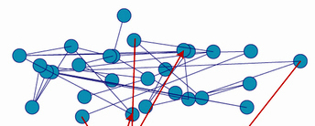
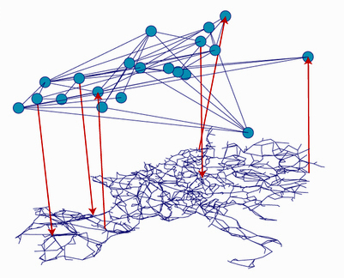
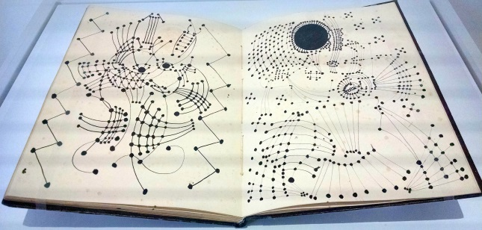
V. Conclusion : Further developments
Reny-Erdös
Hierarchical vs. flat
society
Social distance-
dependent
couplings
Geographical
distance-
dependent
couplings
Mean field model
Monte Carlo simulations
Picasso networks

Slide 17


World Scientific, 2015, 648 pages
Lectures, Problems, Solutions
⬅
World Scientific, 2014 ➔
450 pages
Lectures, Problems, Solutions

